Slide 1
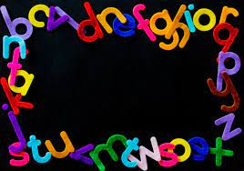
Phonics and Reading

Slide 2
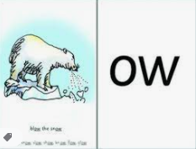
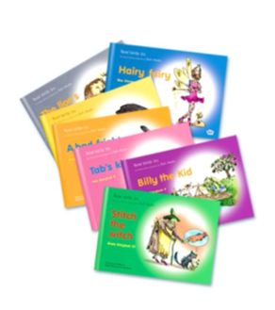
PHONICS
The focus of Read Write Inc is to teach children all the required sounds and give them the opportunity to apply them to single words first then on to sentences then books.
Each phonics lesson has two parts.
1) speed sound lesson
2) reading activities (Word Time, Ditties, Books)

Slide 3
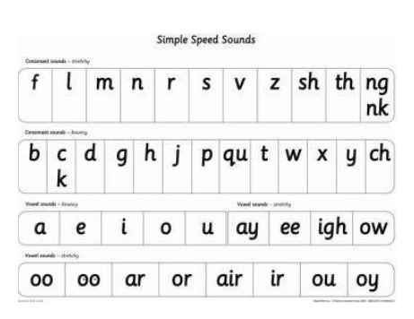
w
The sounds the children need to know by the end of Year 1 are split into 3 sets.
Set 1 sounds are the letters of the alphabet plus sh, th, ch, ng, nk.
Set 2 sounds are ay ee igh ow (blow) oo (zoo) oo (look) ar or air ir ou oy
The children are taught these sounds in a ‘Speed Sound’ lesson which the children will demonstrate to you shortly.

Slide 4
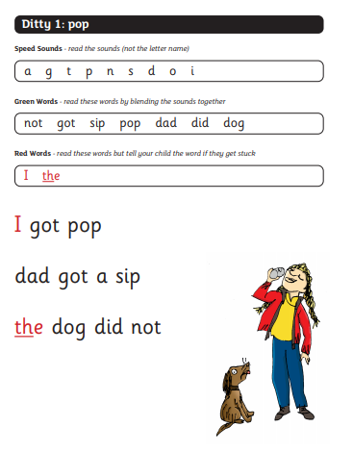

When the children have learned to blend they start reading short sentences in what are called Ditty books.
Ditties

Slide 5
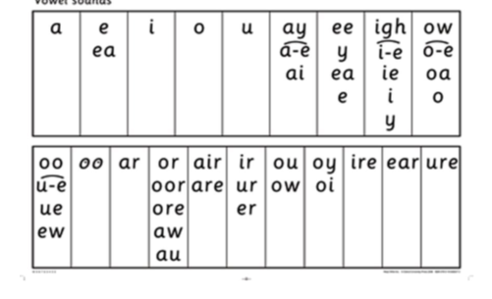
w
Set 3 Sounds.
When children have learnt all the Set 1 and 2 sounds and are blending well they are taught Set 3 sounds which are alternative spellings of the same sounds.

Slide 6
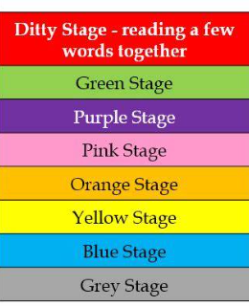
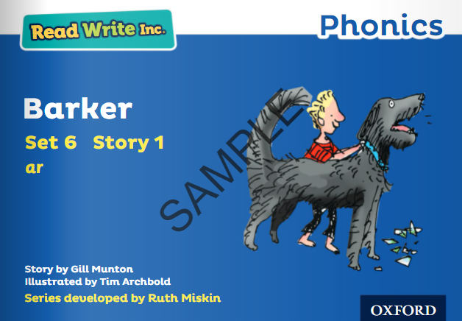
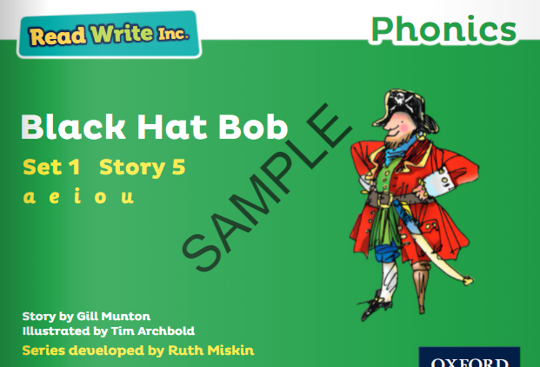
After Ditties the children read longer and more challenging sentences in books. The books get progressively more difficult as they move through the coloured levels.

Slide 7
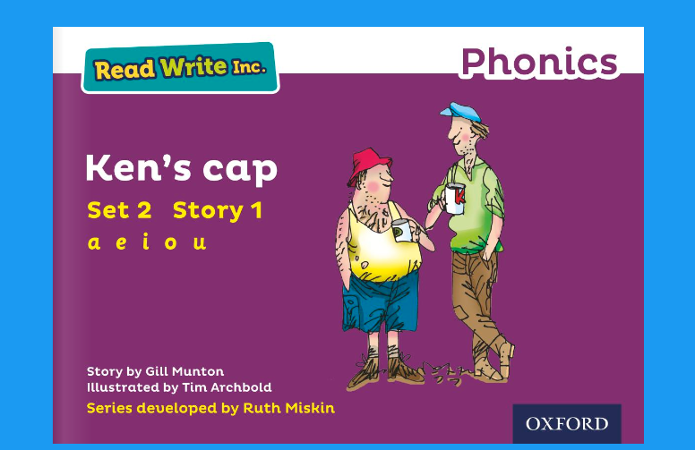
Each week we will send the book home (via Oxford Owl Online) that the children have been reading in class for you to read together.
Purple Set 2 Storybook 1 Ken's cap (oxfordowl.co.uk)

Slide 8
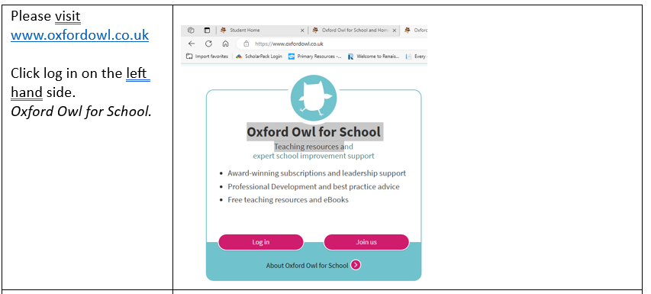
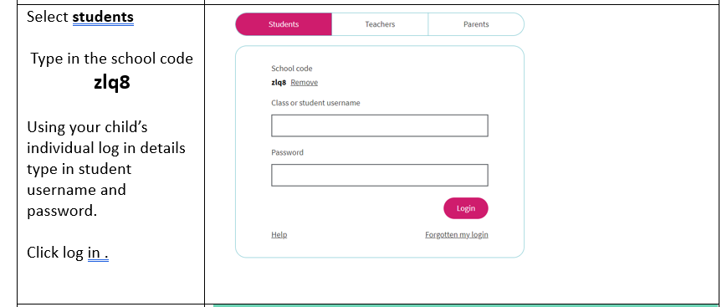

Slide 9
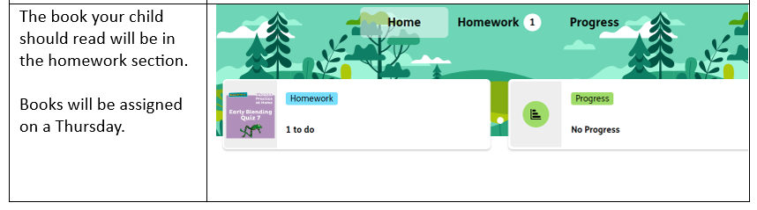


Slide 10
Each week we will send home the book the children have been reading in class for you to read with your child at home.
Purple Set 2 Storybook 1 Ken's cap (oxfordowl.co.uk)

Slide 11

Phonic Screening Check- week beginning 10th June 2024
The Phonics Screening Check is designed to confirm whether a child has mastered phonic decoding and blending skills to an appropriate standard.

Slide 12
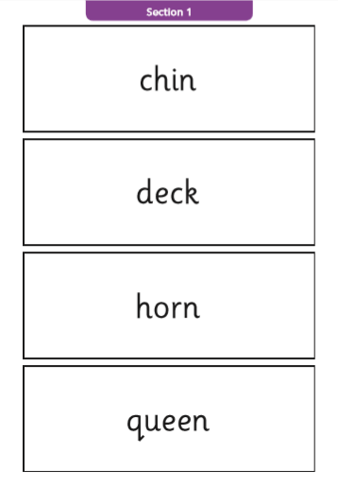
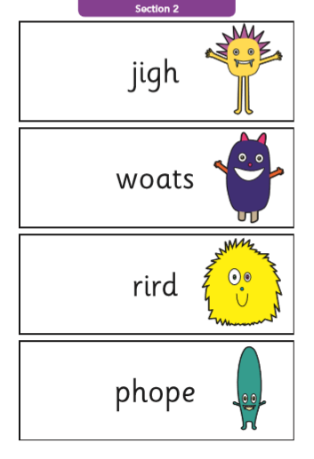
Phonic Screening Check- week beginning 10th June 2023
The list of words the children read is a combination of 20 real words and 20 nonsense words. You may hear your child call them alien words.
Nonsense words are phonetically decodable
but are not actual words with an associated
meaning e.g. brip, snorb. They are used
specifically to assess whether your child
can decode a word using phonics skills and
not their memory.

