Slide 1
Welcome to Burlish Park Primary
Burlish Park Primary School is proud to be a part of The Rivers C of E Academy Trust.
An extraordinary education for every pupil.
OUR MISSION
Extraordinary education, extraordinary people, extraordinary futures.
OUR VISION
Through an extraordinary education, we empower pupils to be life-long learners and see their limitless potential. Respectful relationships and an unwavering focus on discovering talents and interests, enable pupils to flourish and be extraordinary people. Together, we spark aspiration and drive achievement, so that pupils contribute positively to society and to their extraordinary futures in an ever-changing world.
OUR VALUES
Sharing, Trust, Achievement, Respect and Safety.
Burlish Park Primary School

Slide 2
Burlish Park Primary School
We know how important the early years are for your child.
We want your child to have an extraordinary start to their education.
We have designed an extraordinary curriculum and environment.
Your child will be supported and cared for by an extraordinary team.

Slide 3
Burlish Park Primary School
Starting School
Your child will start their transition into Reception from September.
You child will have 3 dates for transitions sessions before starting in September, these dates are:
Thursday 26th June 9.30 am - 10.30 am
Tuesday 1st July 9.30 am - 10.30 am
Monday 7th July 9.30 am - 2.30 pm (Children will need a packed lunch)
(These dates will be emailed to you.)

Slide 4
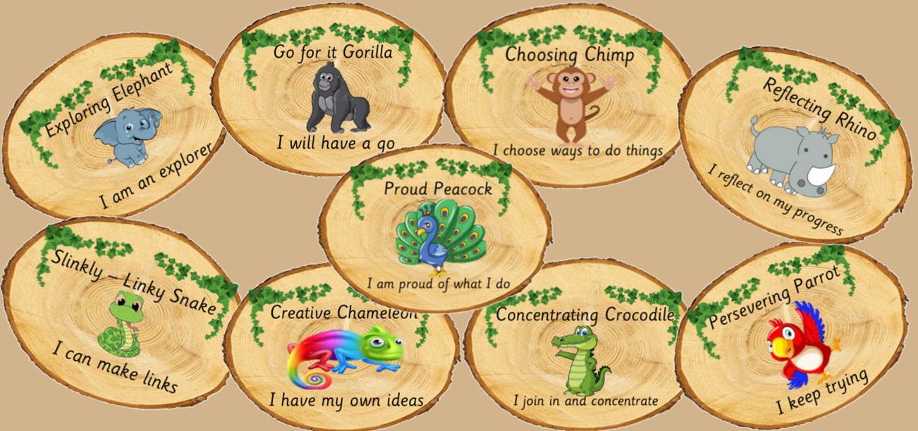
Burlish Park Primary School
Characteristics of Effective Learning at Burlish
We help children recognise their learning behaviours by using the animal images below. We have a board in the classroom where children can move their name to one of the animals when they have displayed one of the characteristics. For example, if a child was independent attempting a task we would ask them to move to ‘Go for it Gorilla’. Children are given a sticker representing the characteristic. When you see a sticker ask your child about it.

Slide 5
Burlish Park Primary School
Seesaw
We use the classroom app Seesaw for learning in school and for remote learning. Seesaw is a way for teachers and children to record and share what is happening in the classroom. Seesaw gives children a place to document their learning, be creative and learn how to use technology. You will be given a QR code to allow your child to sign into Seesaw. Each child gets their own journal and can add things to it, like photos, videos, drawings, or notes.
Teachers approve the activities and give feedback.

Slide 6
Burlish Park Primary School
The first few weeks.
During the first few weeks, we will be finding
out what the children can already do. This will
help us to develop a learning programme for each
child.
Please talk to the teachers about your child. We
will value anything you can tell us that helps
us to understand your child’s needs.
Our first topic will be
‘Marvellous Me ’
We will share knowledge organisers for every topic so that you will know what your child is learning about in school.

Slide 7


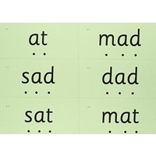
Burlish Park Primary School
Phonics
Phonics Scheme – Read Write Inc
Children are taught ‘pure sounds’
Children learn to read and write sounds (lower case) not letter names (upper case / capitals)
Look out for our Phonics Parent Workshop in the autumn term.

Slide 8


Burlish Park Primary School
Mastering Number
See Mastering Number in action
The first few years of a child’s life are especially important for mathematics development. Research shows that early mathematical knowledge predicts later reading ability and general education and social progress. Conversely, children who start behind in mathematics tend to stay behind throughout their whole educational journey.
The objective for those working in Early Years, is to ensure that all children develop firm mathematical foundations in a way that is engaging, and appropriate for their age.

Slide 9
Burlish Park Primary School
Outdoor Learning
We have outdoor sessions every day.
Please provide a pair of named
wellies for your child to be kept in
school.
We use the outdoor area
in all weathers for curriculum
Activities.
Dirty uniform and messy hair means that fun learning has taken place!

Slide 10
Burlish Park Primary School
Forest School.
Children will take part in Forest School every other half term.
They will need:
Wellies (also used for Outdoor Learning)
Extra layers (e.g. fleece , jumper)
Extra socks
Hat, scarf and gloves
ALL NAMED PLEASE!
Children should come to school in their
Forest School clothes ready for their sessions.

Slide 11
Burlish Park Primary School
If you are able to help at Forest School on a regular weekly basis then please let us know.
We are always grateful for regular helpers.
A DBS check is required.

Slide 12

Burlish Park Primary School
P.E.
Children will need:
Navy/black track suit
Navy/black shorts
Either a white polo shirt or one in their house colour (see your pack for information about your child’s house team)
Trainers will be needed all year round
Please name all kit clearly and send in a PE bag that can be hung on a peg.

Slide 13
Burlish Park Primary School
Personalised learning.
Celebrating your child is an important part of our curriculum!
We want to make sure that we celebrate your child's interests and achievements.
One child per week is chosen as our Star of the week.
Our curriculum and learning environment is created to spark interest and joy.
We want to follow the interests and enjoyments of your child, if you have photos or objects that support learning we are doing in school – please share them!

Slide 14
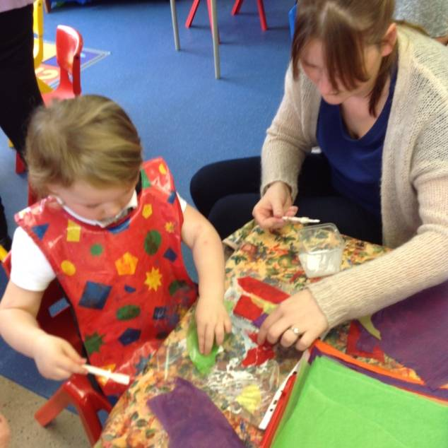
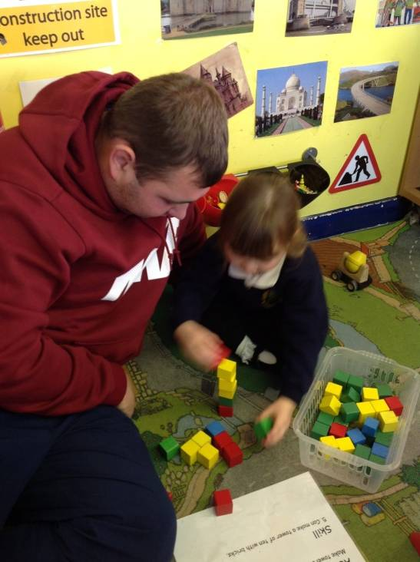
Burlish Park Primary School
Parent Workshops
Throughout the year we will be able inviting you to various
Parent Workshops and Parent Pop-Ins
to find out more about what your child is learning at school.
These are very important for you as parents to ensure that you are aware of how to support your child at home with vital skills such as reading, writing and maths.

Slide 15
Burlish Park Primary School
Healthy Eating
Children are entitled to free milk until they are five and free fruit, which we strongly encourage and we would be grateful if you would encourage this too.
Children may bring their own piece of fruit if they prefer.
Please follow the Food Standards Agency guidance for Early Years children.
Early years food choking hazards information

Slide 16




Burlish Park Primary School
Healthy Eating
Children should bring a drink in a named bottle every day.
They must be able to independently open the bottle.
There are lots of bottles on the market, try to invest in one that does not leak and is suited to your child's needs.
Children can easily manage this size and they are leak proof! Ask us for more information.

Slide 17
Burlish Park Primary School
School lunches.
All children are now entitled to a free meal at school everyday, until the end of Year 2.
Please complete the menu choices online through ParentPay. This needs to be completed a week in advance by the Tuesday.
Packed lunches from home are still acceptable if you prefer. However, sandwiches are available from the school meals provider.
Please note that we are a nut free school and that we ask parents and carers to cut grapes in half length ways.
No sweets in lunch boxes, please.
Early years food choking hazards information

Slide 18
Burlish Park Primary School
Currently, all children receive a free meal in Reception, Year 1 and Year 2, but if you apply for the status of ‘Free School Meals’, your child will continue to receive a free school meal in Year 3 onwards. In addition, the school will receive additional funds to spend on their education from Reception onwards. The school decides how best to spend this allocation, typically we fund social and emotional support, small group work or 1:1 support along with purchasing new resources and engaging activities to meet your child’s needs.
On confirmation of eligibility, we will provide your child with a school jumper and a book bag. If you would like some additional information regarding this matter please contact r the school office for confidential help and support – or use the web link below to apply online.
Apply for free school meals | Worcestershire County Council
Free School Meals can be awarded if you or your partner are claiming either;
• Universal Credit provided the annual net earned income does not exceed £7,400 (616.67 per month)
• Income Support
• Income-based Jobseeker's Allowance
• Support under Part 6 of the Immigration and Asylum Act 1999
• Guaranted Pension Credit
• Child Tax Credit, provided they are not also entitled to Working Tax Credit and have an annual gross income of no more than £16,190, as assessed by HMRC
• Working Tax Credit run-on-paid for 4 weeks after you stop qualifying for Working Tax

Slide 19
Burlish Park Primary School
Uniform
Uniform is described on the website. https://www.burlishpark.co.uk/parents-and-carers/uniform/
Please order uniform online from Brigade Clothing My Clothing
Please ensure that everything is clearly named – even shoes!

Slide 20
Burlish Park Primary School
Book Bags NOT Backpacks please
Your child will need a book bag which can also be ordered purchased from Simply School Uniform or My Clothing.
The book bag needs to be brought to school every day. Please make sure your child also brings their school reading book every day.
Space is at a premium in our environment – your support with just sending in a bookbag is much appreciated.

Slide 21
Burlish Park Primary School
ParentPay
Accessed through our website.
https://www.burlishpark.co.uk/parentpay-2/
Every child has an individual log in code. This is where you pay for everything, eg, trips and activities. We are now a cash free school. This will be sent to you once your child is on role.

Slide 22
Burlish Park Primary School
Attendance Matters
Good attendance is vital for all children to be confident, happy and independent learners.
Excellent attendance is crucial in ensuring children are settled in school and have the best opportunity to receive a complete education.
All children are expected to attend school every day.
Absences – Parents/carers have a duty to notify the school if their child/children are absent for any reason and this needs to be done by 9:30am. The school will contact parents/carers if notification is not received by this time.
Holidays – Holidays are not permitted in term time. All holidays are unauthorised except in exceptional circumstances and can incur a fine.
Please help us to ensure that your child/children receive the very best possible education they can by ensuring they are in school every day and that they are on time.

Slide 23
Burlish Park Primary School
Impact of Absence on a child’s Attendance (by the end of each academic year)
Number of Days Absent | % Attendance | Attendance Rating
0 days | 100% | Outstanding
1 day | 99.5% | Outstanding
2 days | 99% | Outstanding
3 days | 98.5% | Outstanding
4 days | 98% | Outstanding
5 days = 1 week | 97.5% | Good
10 days = 2 weeks | 94.5% | Poor (Possible fine/legal action)
15 days = 3 weeks | 92.5% | Poor (Possible fine/legal action)
20 days = 4 weeks | 90% | Persistent Absenteeism (Fine/legal action)
25 days = 5 weeks | 87.5% | Persistent Absenteeism (Fine/legal action)
30 days = 6 weeks | 85% | Persistent Absenteeism (Fine/legal action)
35 days = 7 weeks | 82.5% | Persistent Absenteeism (Fine/legal action)

Slide 24
Burlish Park Primary School
Contact Numbers
It is vital that contact numbers are kept up to date. Please tell the office staff if your
phone number changes.
Email: office-bp@riverscofe.co.uk
Use this email address if you have any further questions.

Slide 25
Burlish Park Primary School
Playing is vital work … it is how young children learn best.
    “Adults who help children to play are adults who help children to learn.”
    SHrec Approach Information

